Slide 1
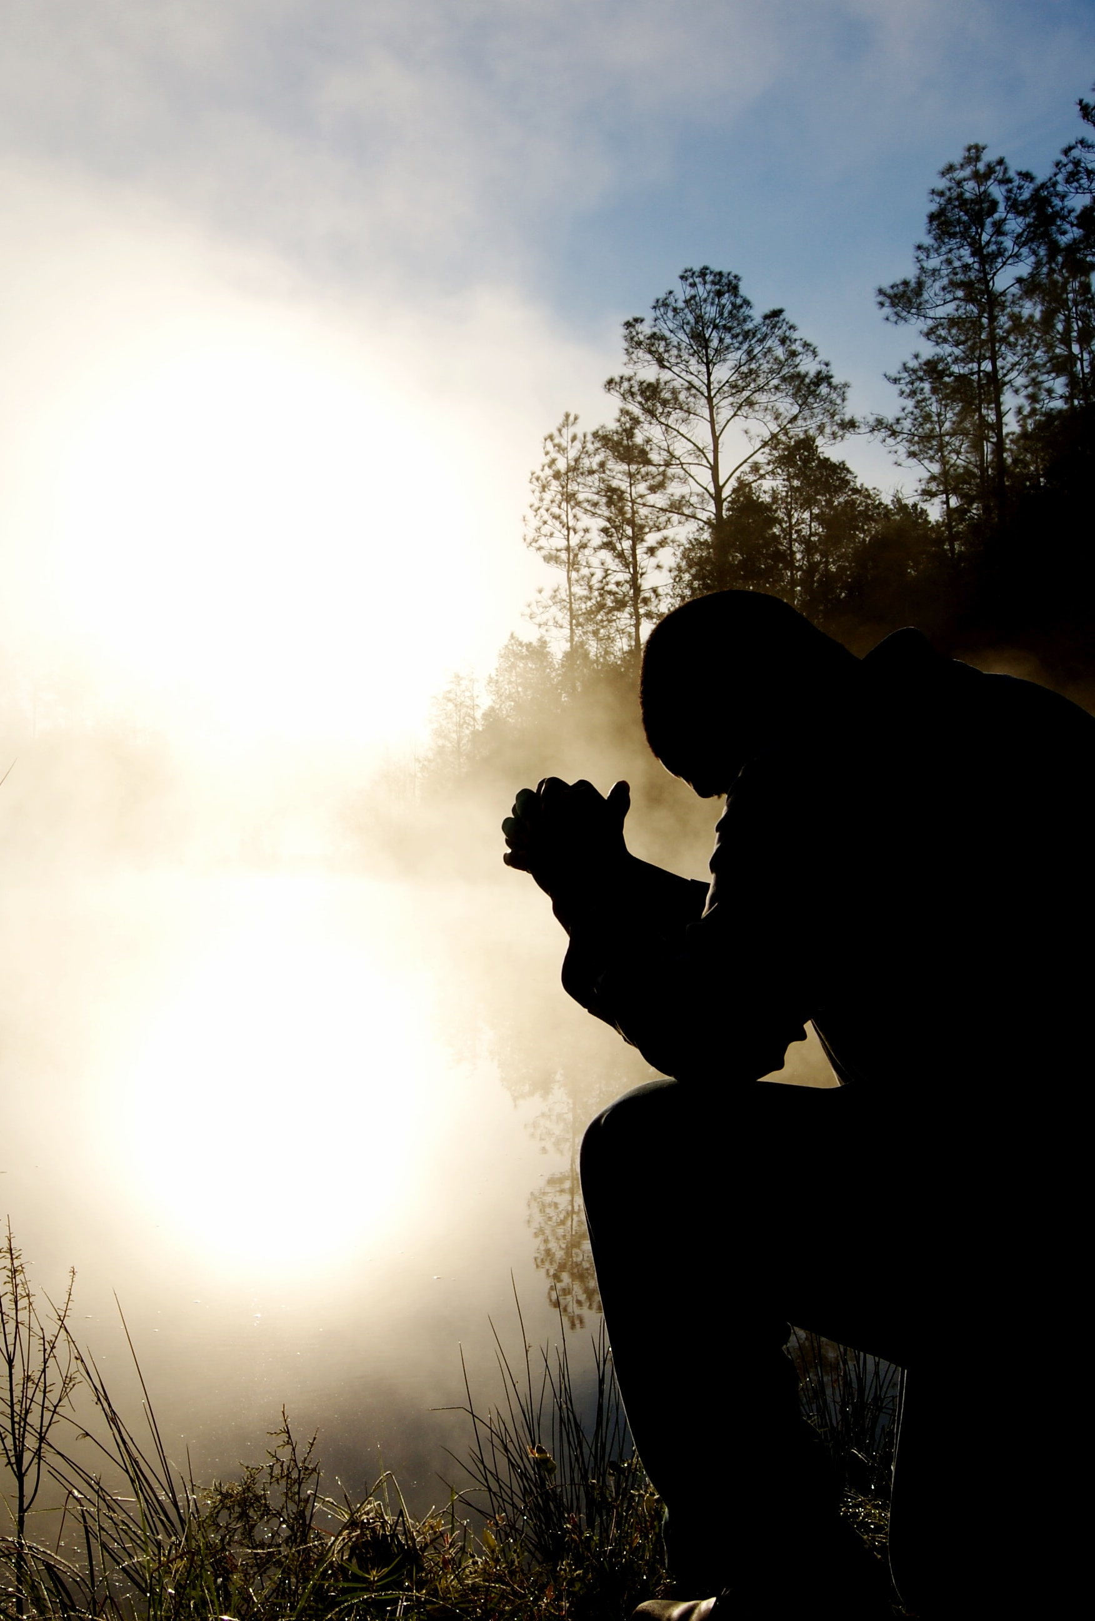
Give thanks to the Lord, for he is good. His faithful love endures forever.
--1 Chronicles 16:34

